Slide 1
Physiology of the motor system
Fall 2009
Opher Donchin

Slide 2
Sensation and perception
Last class we studied perception
  How does the information get into the system
Today we’ll talk about perception
  How does the information get processed
  Into what we experience
  Into a model of what is out there

Slide 3
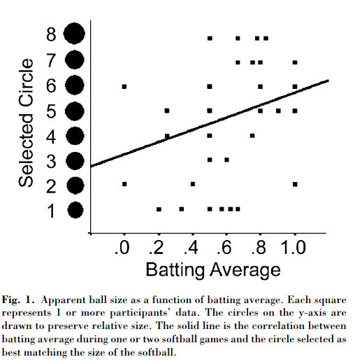
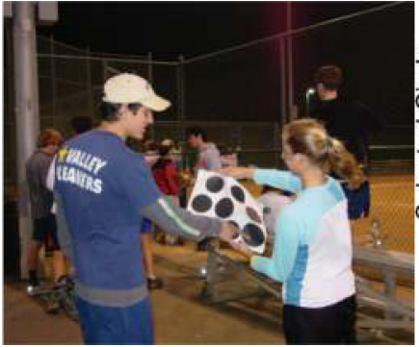
Better hitters see a bigger ball
Witt Psychological Science 2005 16:937

Slide 4
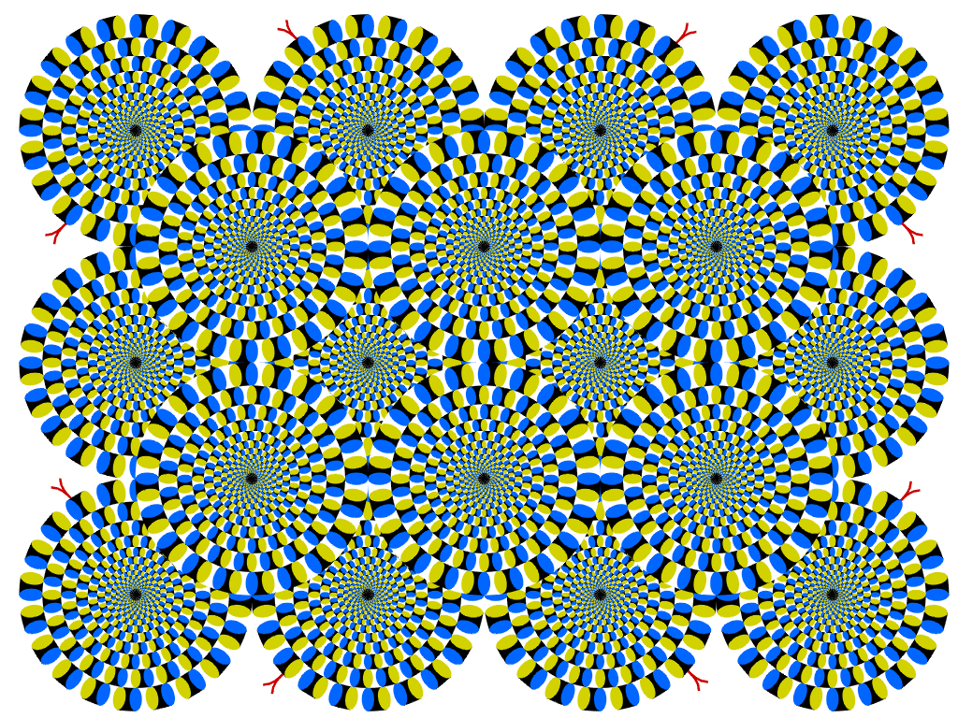
Study perceptions through illusions

Slide 5
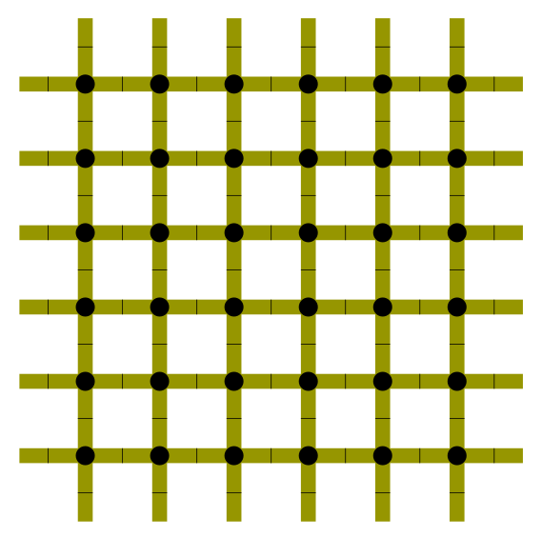
Retinal contrast calculations create this illusion

Slide 6
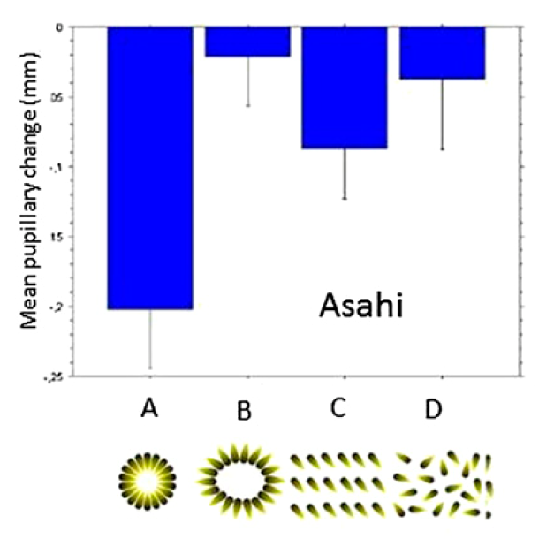

This illusion affects pupil size
Laeng PNAS 2012 109:2162

Slide 7

Stronger version of the effect

Slide 8
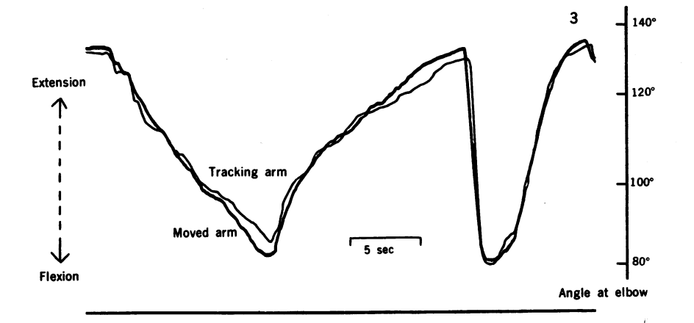
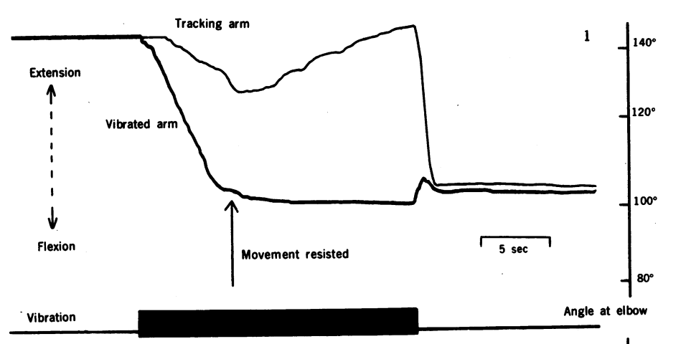
Prprioceptive illusion
Vibration of the flexor muscle tendon causes the arm to flex and a sense that the arm is being extended.
Goodwin Nature 1978 175:1382

Slide 9
Illusions teach about sensory processing
Vibrated tendon illusion
  Excites muscle tendon organ
  Signal indicates increased muscle tension
    Increase muscle activation
      Arm moves
    But feeling increased tension continues
      Feel like the arm is extending

Slide 10

Illusions can reflect expectations
Light comes from above
Ramachandran Nature 1988 331:163

Slide 11
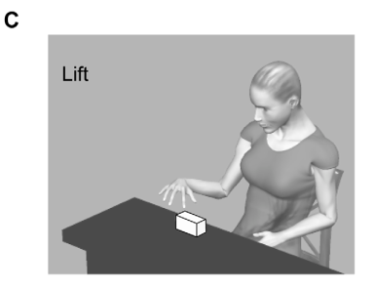
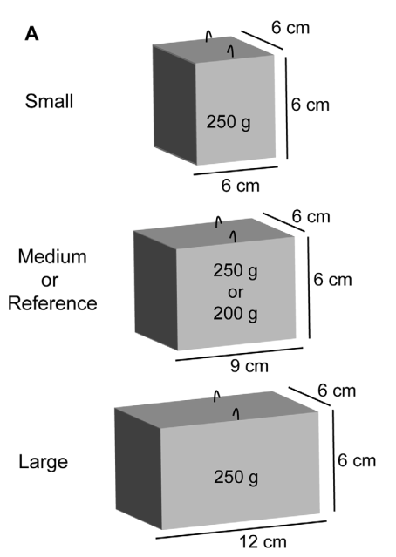
Size / weight illusion
Which box will feel heavier?
Plaisier PLOS One 2012 doi:10.1371/journal.pone.0042518

Slide 12
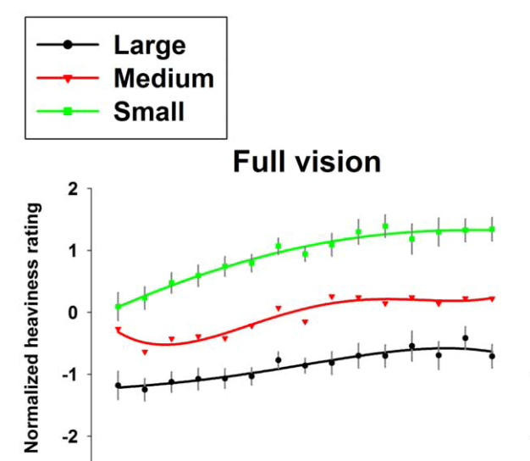
First reported in 1889
Buckingham PLOS One 2010 doi:10.1371/journal.pone.0009709

Slide 13
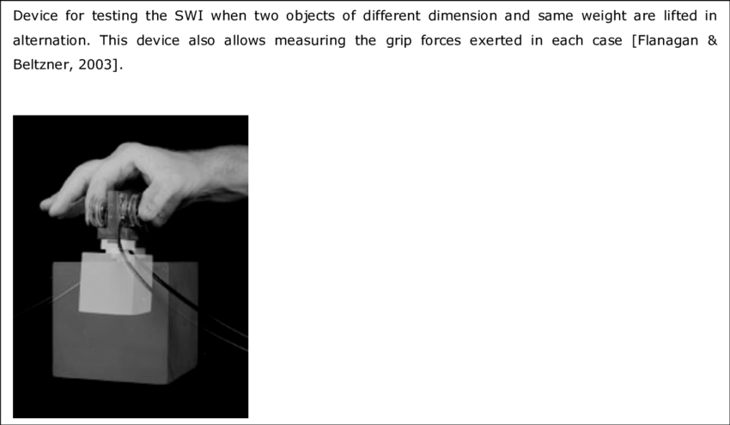
Is the motor system also fooled?

Slide 14
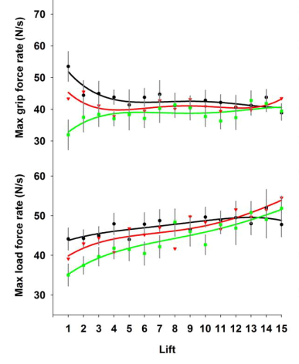
The motor system is not fooled
Buckingham PLOS One 2010 doi:10.1371/journal.pone.0009709

Slide 15
Explanations of the size weight illusion
Greater motor output makes heavy object feel lighter
  Illusion persists after motor output adapts
Expected weight affects weight perception
  Size-material illusion
  Expectation can be reversed with enough practice

Slide 16

Illusions of multiple senses
The McGurk effect

Slide 17
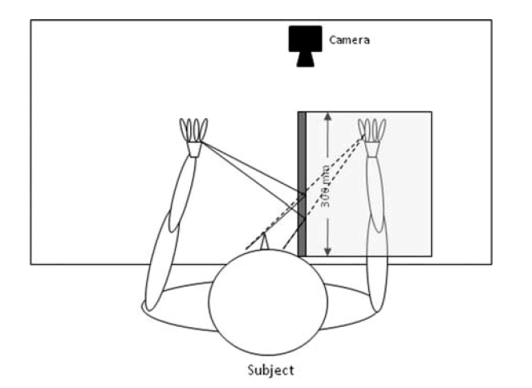
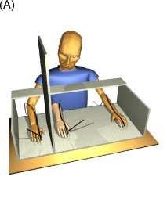
The mirror box and the rubber hand
Two illusions that give us the feeling we are seeing both hands

Slide 18

The mirror box illusion

Slide 19

The rubber hand illusion

Slide 20
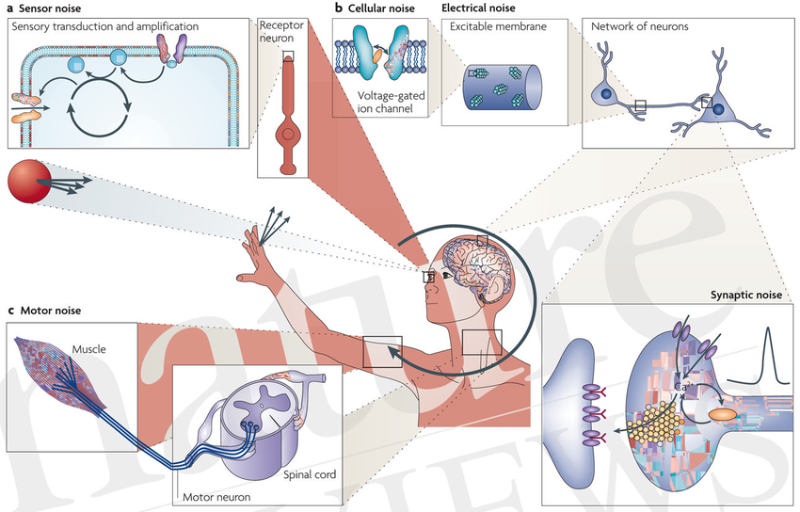
Senses combine in the face of noise
Faisal Nature Reviews Neuro 2009 doi:10.1038/nrn2258

Slide 21
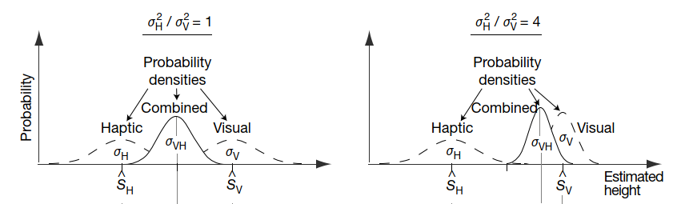
Noise levels affect optimal combination
We put more weight on the sensory input with less noise
Optimal combination is done using Bayesian estimation
Ernst Nature 2002 doi:10.1038/415429a

Slide 22
Bayesian estimation explains a lot
The role of expectations
Adaptation with repeated exposure
Weighting of different estimates

